Slide 1

SinReQ Generalized Sinusoidal Regularization for Low-Bitwidth Deep Quantized Training
Ahmed T. Elthakeb, Prannoy Pilligundla, Hadi Esmaeilzadeh
Alternative Computing Technologies (ACT) Lab
University of California, San Diego

Slide 2
Scope
Obtaining a quantized neural network can be divided into two categories:
Full precision training from scratch
Dataset
Model Initialization
Training
FP
Trained Model
Inference
Quantized
Training
Quantized
Model
(a) Quantized training from scratch
Quantization
Fine-tuning
Quantized
Model
[1] DoReFa-Net: Zhou et. al., 2016
[2] BinaryConnect: Courbariaux et. al., NeurIPS 2015
[3] BNN: Courbariaux et. al., NeurIPS 2016
[4] XNOR: Rastegari et. al., ECCV 2016
[5] QNN: Hubara et. al., 2016
[6] Gupta et. al., ICML 2015
[7] Lin et. al., ICML 2016
[8] Hwang et. al., SiPS 2014
[9] Anwar et. al., ICASSP 2015
[10] Zhu et. al., ICLR 2017
[11] Zhou et. al., ICLR 2017
(b) Fine-tuning
SinReQ is a quantization friendly regularization technique that supports both categories
[12] SinReQ: Elthakeb et. al., ICML Workshop on Generalization of DL, 2019
Notes:
As you may know, quantization has shown to be an effective method while deploying neural network models to systems for efficient inference.
But how do you get those quantized network?
Naturally, there are two ways to obtaining a neural network (1) training a quantized network from scratch
(2) getting a full precision model and running it through a fine-tuning process for quantization.
We introduce a regularization technique that can support both of these quantization techniques.

Slide 3
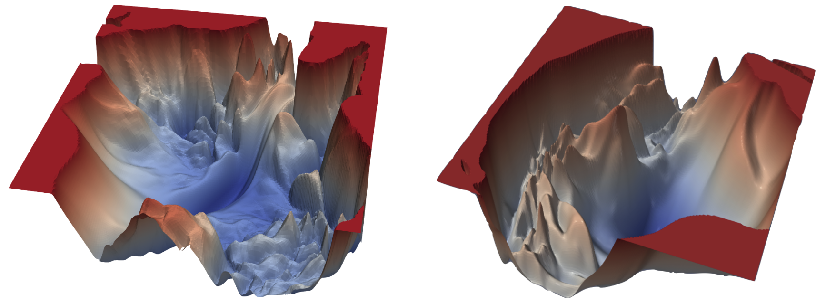
Background Loss Landscape of Neural Networks (1)
VGG-56
VGG-110
It has been empirically verified that loss surfaces for large neural networks have many local minima
Hao Li, et. al., “Visualizing the Loss Landscape of Neural Nets”, NeurIPS 2018
Notes:
Before we go deep about quantization, we must not that it has been empirically been verified that loss surface for large neural networks have many local minima

Slide 4
Background Loss Landscape of Neural Networks (2)
For large-size networks, most local minima are equivalent and yield similar performance on a test set
A. Choromanska et. al., “The Loss Surfaces of Multilayer Networks”, AISTATS 2015
This opens up and encourages a possibility of adding extra custom objectives to optimize for during the training process, in addition to the original objective
Notes:
Furthermore, a work by Anna shows that most of those local minima are equivalent and yield similar performance on a test set.
This means that there could be a certain combination of weights could be a local minima that would yield a similar performance as what full precision model would achieve.

Slide 5
Approach: Regularization perspective (1) Regularization in Neural Networks
Definition:
Adding extra terms in the objective function that can be thought of as corresponding to a soft constraint on the parameter values
With the purpose of:
Reducing the generalization error but not the training error
Adding restrictions (imposing preference) on the parameter values (weights)
Notes:
In order to find this, we introduce a regularization method that can be used with any prior work on quantization.
Regularization is not a new term.
Regularization is by definition, adding extra terms in the objective function that can be thought of as a soft constraint on the parameter values.
With (1) reducing generalization error (2) adding restrictions on parameter values.

Slide 6
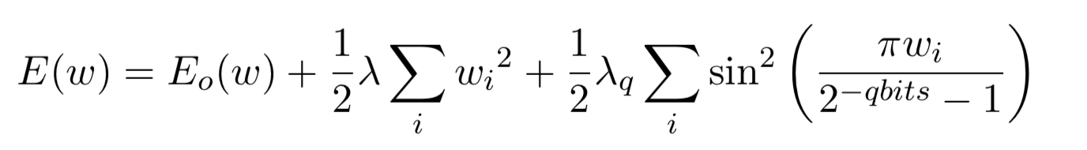
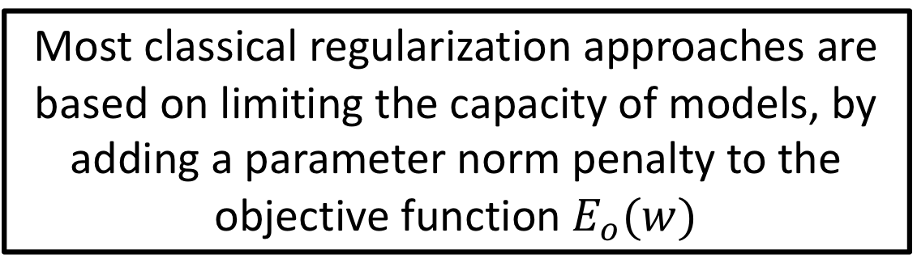


Approach: Regularization Perspective (2) Classical Regularization: Weight Decay
Most classical regularization approaches are based on limiting the capacity of models, by adding a parameter norm penalty to the objective function $E_{o}(w)$
$$w_{opt,new}$$
The overall optimum solution ($w_{opt,new}$) is achieved by striking a balance between the original loss term and the regularization loss term
Regularization
constraint
Notes:
So, if we look at classical regularization approaches, they are based on a simple term that is added to the objective function with a goal “increasing the generalization performance” by preventing a single value from growing too large, causing bias

Slide 7
Regularization Perspective (3) Proposed Approach: Periodic Regularization (SinReQ)
SinReQ (periodic regularizer) has a periodic pattern of minima that correspond to the desired quantization levels
Such correspondence is achieved by matching the period to the quantization step based on a particular number of bits for a given layer
Periodic pattern of minima
Notes:
Using same analogy… we can ask ourselves, why can’t we make the goal to be “making the weights go close to quantized values?”
Because (1) there likely is a quantized set of weights that would achieve similar accuracy as the full precision ones
And (2) we just found out that regularization can be used as a soft constraint to help us achieve that objective without any changes to the original training algorithm or the model

Slide 8
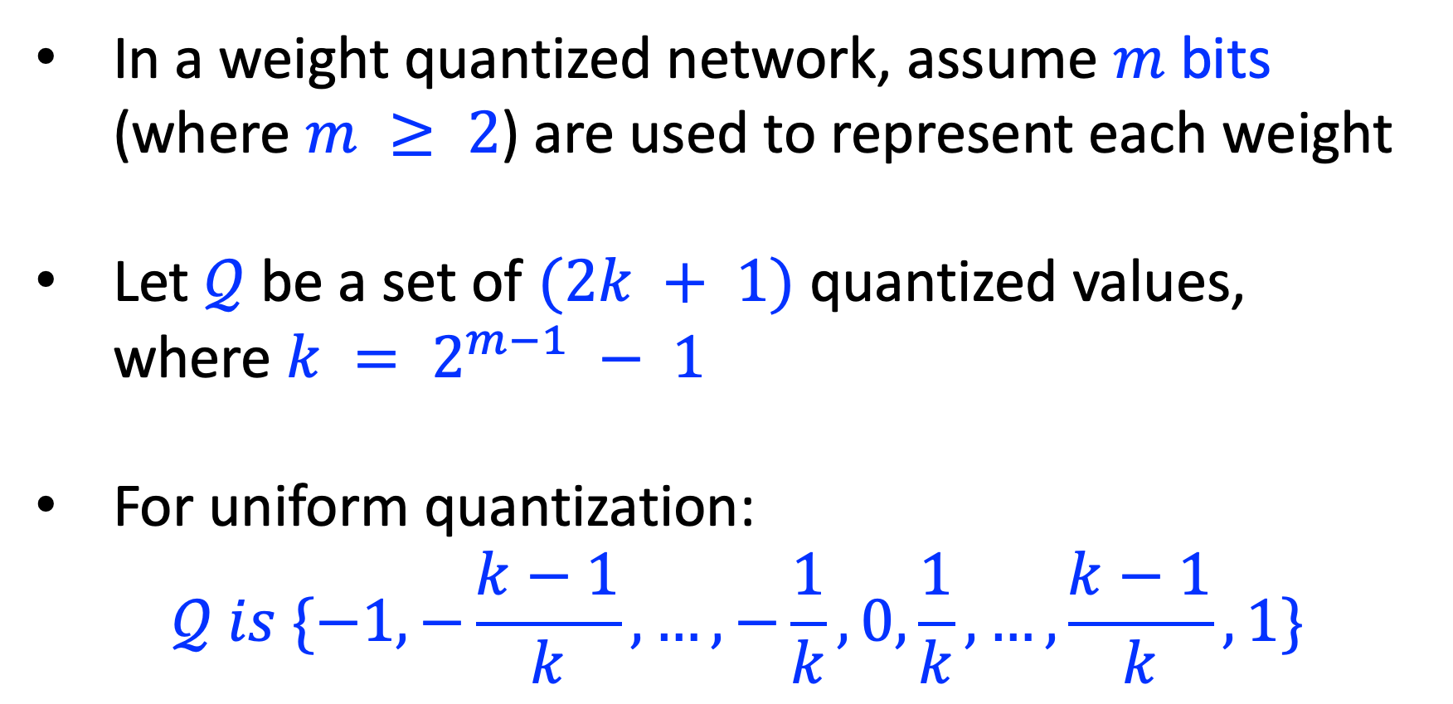
Optimization perspective (1) Quantization as a hard constraint (Notation)
In a weight quantized network, assume $m$ bits (where $m ≥ 2$) are used to represent each weight
Let $𝒬$ be a set of $(2k + 1)$quantized values, where $k = 2^{m−1} − 1$
For uniform quantization:
$$𝒬 is \{−1, −\frac{k−1}{k}, …, −\frac{1}{k},0, \frac{1}{k},…,\frac{k−1}{k}, 1\}$$
Notes:
So now, we have the high level idea, lets go into the details.
First, the quantization
By definition,
When there are m bits --> there will be 2 ^ (m-1)
When m = 3, k would be 3, and number of Q (quantized values) will be 7
So when we divide a value between -1 to 1 to 2k + 1 levels, range of values will be as shown
-1, -(k-1) / k … 1

Slide 9
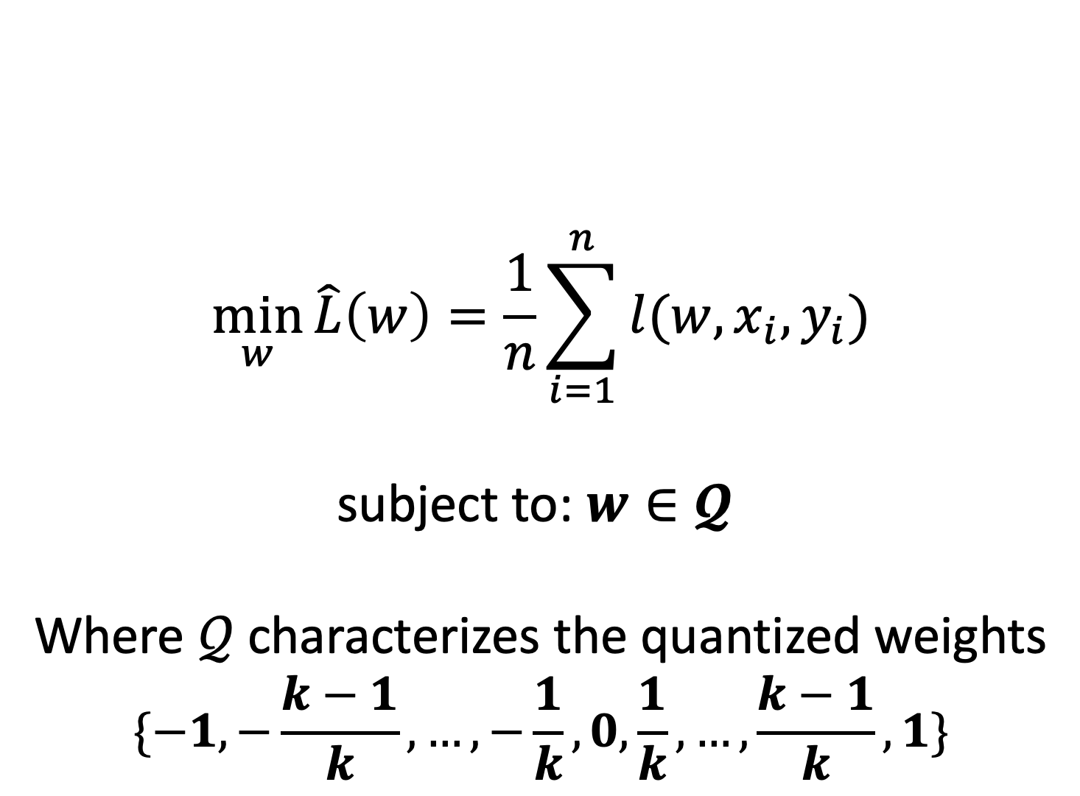
Optimization perspective (2) Quantization as a hard constraint:
$$\min_{w}{\hat{L}\left(w\right)=\frac{1}{n}\sum_{i=1}^{n}{l(w,x_{i},y_{i})}}$$
subject to: $w∈𝓠$
Where $𝒬$characterizes the quantized weights
$$\{−1, −\frac{k−1}{k}, …, −\frac{1}{k},0, \frac{1}{k},…,\frac{k−1}{k}, 1\}$$
Discrete constraint
Introduces a discontinuity
Notes:
And if we just put that constraint on the weights
It is unlikely that we get a good performance because they would cause large differences…
Furthermore, discrete nature of the weights introduces discontinuity, and such discontinuity is never favorable…

Slide 10
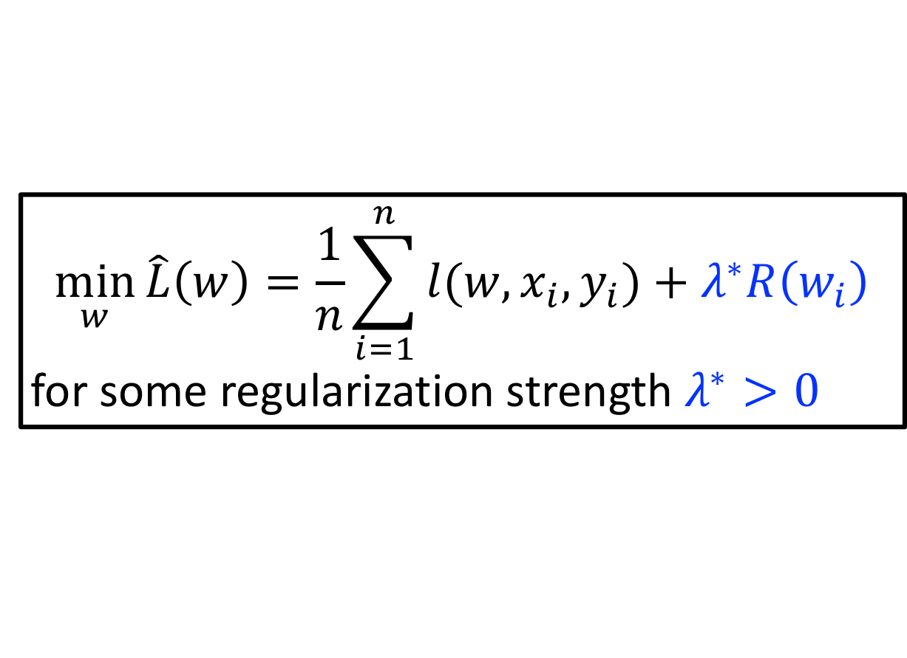
Optimization perspective (3) Quantization as a soft constraint
Make use of regularization; recall:
Convert the hard-constraint optimization to an equivalent soft-constraint
Adding extra terms in the objective function that can be thought of as corresponding to a soft constraint on the parameter values
$$\min_{w}{\hat{L}\left(w\right)=\frac{1}{n}\sum_{i=1}^{n}{l(w,x_{i},y_{i})}}+λ^{∗}R\left(w_{i}\right)$$
for some regularization strength $λ^{∗}>0$
(Unconditionally constrained)
→ Smooth & differentiable
Notes:
So we want to soften up this constraint a little.
So recalling the definition the regularization, we add a regularization term that can put a similar but a soft constraint.

Slide 11
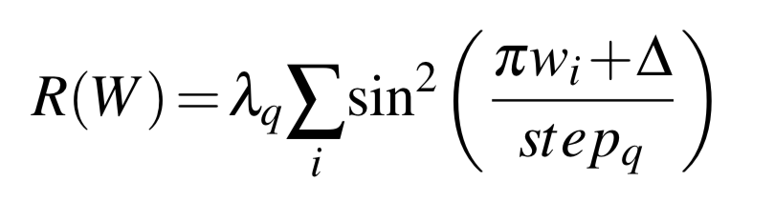
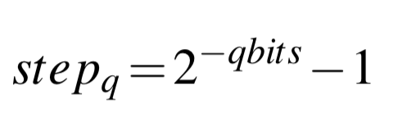
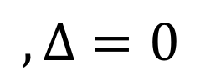
Proposed Approach Periodic Regularization: SinReQ
$$, Δ=0$$
SinReQ exploits the periodicity, differentiability, and the desired convexity profile in sinusoidal functions to automatically propel weights towards values that are inherently closer to quantization levels.
Notes:
We exploit periodicity, differentiability, and convexity so that we can make the weights to propel towards certain values while still aiming for the goal of achieving a good generalization performance.

Slide 12
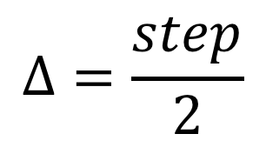
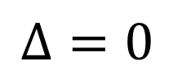
SinReQ support features
Support for arbitrary-bitwidth quantization
Support for arbitrary quantization techniques
Weight
Mid-rise
Mid-tread
$$Δ=\frac{step}{2}$$
$$Δ=0$$
(0 is not included as a quantization level)
Weight
Notes:
This method is pretty flexible, and it supports arbitrary-bitwidth quantization and difference techniques.

Slide 13
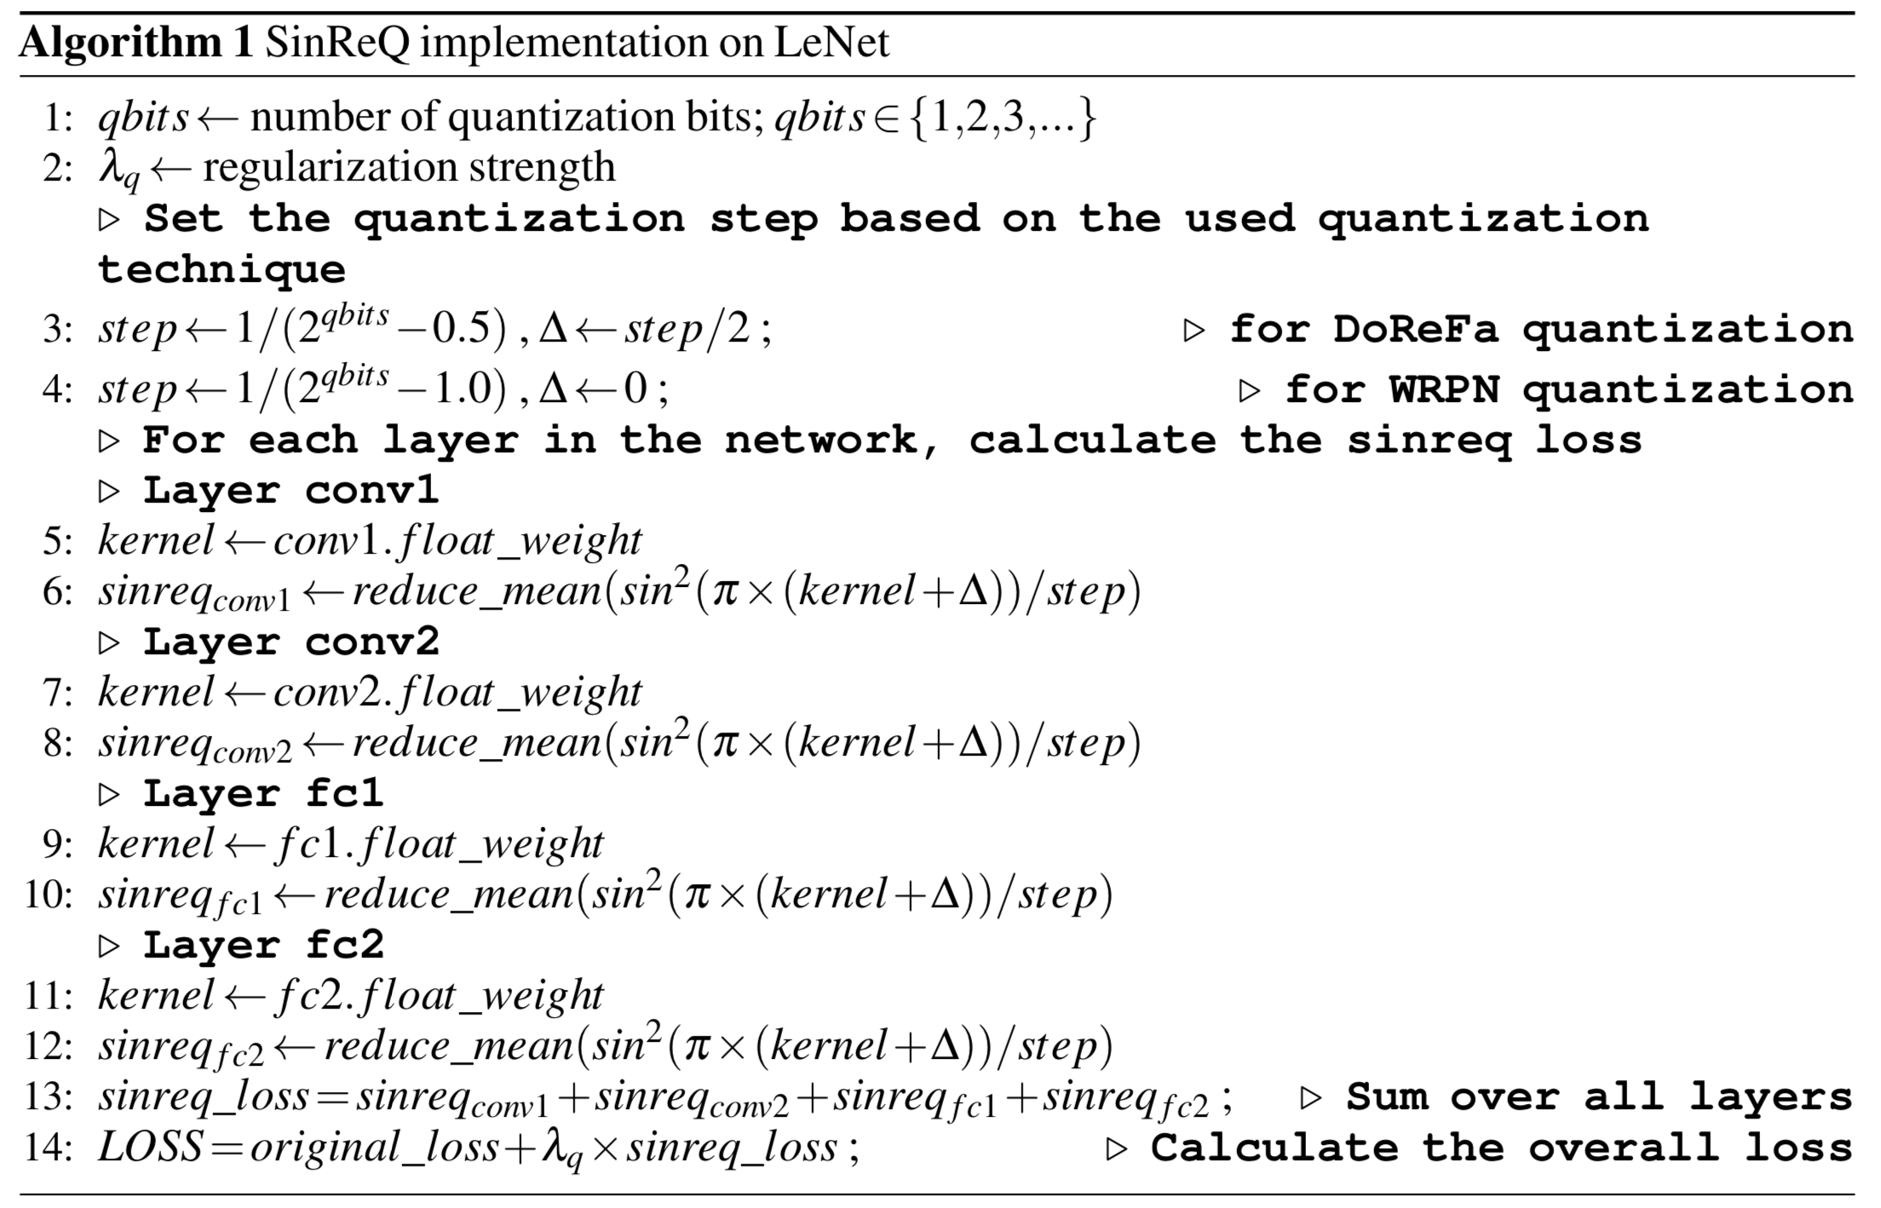
Start by setting the quantization bitwidth and the regularization strength
(Possibly could be per layer assignment)
Based on the quantization technique, calculate step and delta
For each layer, calculate the SinReQ loss
Sum up losses across all layers and add to the original objective and send to the optimizer to minimize

Slide 14
Experimental Results (2)
Evolution of weight distributions over training epochs (with the proposed regularization) at different layers and bitwidths: CIFAR10
Notes:
This is our result from CIFAR 10,
We can see that, as we go along stages of finetuning epochs, weight values cluster towards certain values or to different bins, which correspond to different values in quantization.
Therefore, when we get to the last step of finetuning, we can apply quantization while incurring minimum amount of difference to the weights

Slide 15
Experimental Results (3)
Evolution of weight distributions over training epochs (with the proposed regularization) at different layers and bitwidths: SVHN
Notes:
Furthermore, this is our result from SVHN,
We can also see a similar behavior as CIFAR10.

Slide 16
Experimental Results (4)
SinReQ closes the accuracy gap between DoReFa and WRPN, and the full-precision runs by 35.7% and 37.1%, respectively.
That is improving the absolute accuracy of DoReFa and WRPN up to 5.3% and 2.6%, respectively.
Notes:
So putting it all together, these are the accuracy for each case.
Just training with Dorefa, WRPN vs when we apply it with SinReQ / then on the right most column we present full precision accuracy.
We can see that when Dorefa and WRPN is used with SinReQ, we earn upto 5.3% and 2.6% respectively.

Slide 17
Experimental Results (5)
Convergence Behavior: Fine-tuning
(a) CIFAR-10
(b) SVHN
Regularization loss (SinReQ Loss) is minimized across the finetuning epochs while the accuracy is maximized validating the ability of optimizing the two objectives simultaneously
Notes:
Classification accuracy + sinreq loss

Slide 18
Conclusion
We proposed a new approach in which sinusoidal regularization terms are used to push the weight values closer to the quantized levels
This proposed mathematical approach is versatile and augments other quantized training algorithms by improving the quality of the network they train
While this technique consistently improves the accuracy, SinReQ does not require changes to the base training algorithm or the neural network topology

Slide 19
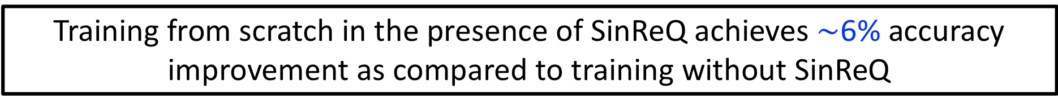

Experimental Results (6)
Convergence Behavior: Training from Scratch
$\sim$6% accuracy
improvement
Training from scratch in the presence of SinReQ achieves $\sim$6% accuracy improvement as compared to training without SinReQ
Notes:
Learning rate: 0.001

